Slide 1
Climatic Zones
and
Wildlife of Canada

Slide 2
Climatic Zones
Canada is divided
into nine
climatic zones:
Oceans
Fresh waters
Moderate forest
Taiga
Moderate meadows
Tundra
Polar ice
Deserts
Mountains

Slide 3
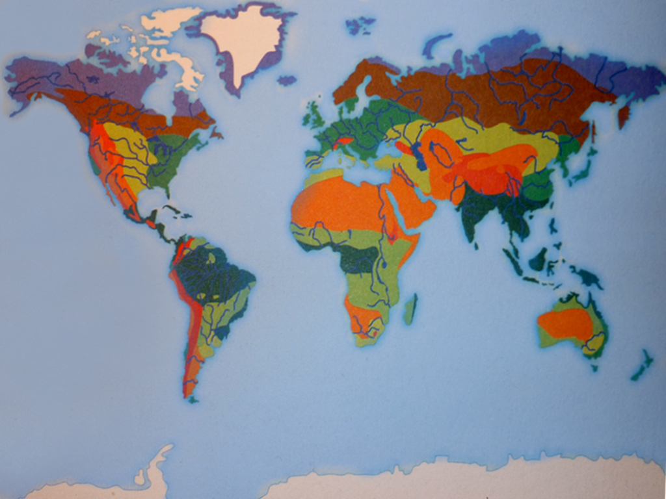

Slide 4
Hunchbacked whale
Habitat: Deep
waters
Food: Small fish
dolphins
Weight: 30 ton
Length: 15 m
Duration of life:
70 years

Slide 5
Rabbit
Habitat: Coniferous forest
Food: Grass
Weight: 5 kg
Length:
60 cm
Duration of
life:
5 years

Slide 6
Moose
Habitat:
Forest
Food:
plants
Weight:
600 kg
Length:
3 m
Duration of life: 30 years

Slide 7
Puma
Habitat: Mountains
forests
Food: Dears
rabbits
Weight: 80 kg
Length: 2 m
Duration of life:
20 years

Slide 8
Polar bear
Habitat: Ice fields
Food: Fish, dears
Weight: 350 kg
Length: 2 m
Duration of life: 30 years

Slide 9
Wolf
Habitat: Forests
Food: dears
moose
Weight: 50 kg
Length: 1.5 m
Duration of life:
20 years

Slide 10
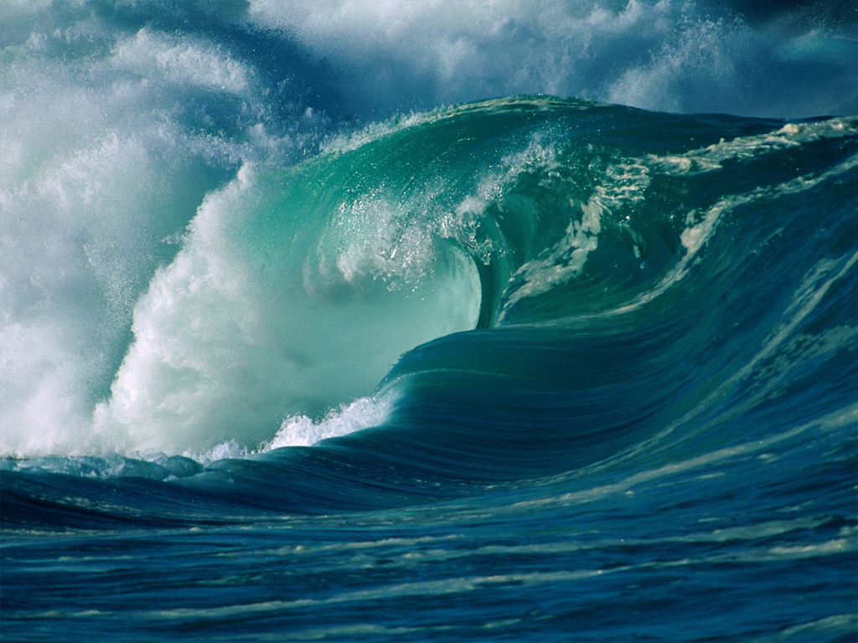
Thanks for the attention)

